Slide 1
NetWORK Project
November 8th 2018

Slide 2
Project AIM
This project was a collaboration between Cultúr Migrant Centre and Meath Partnership.
It focused on developing and delivering a ready-for-life and work skills programme for refugee women and women on Stamp 4.
Net-WORK provided a comprehensive life skills employability programme that equipped 85 migrant women with the skills required to succeed in Ireland

Slide 3
COURSES DELIVERED
Soft Skills and Accredited Courses:-
Soft Skills Course
1. Start Your Own Business QQI 2.Career Preparation Course
3. One-One support 4. Personal Development
Accredited Courses
HACCAP 2. Academy of Aviation Courses 3. First Aid
Empowerment Courses
Jewelry Making
Sugar Craft

Slide 4
Project impact
35 Completed Academy of Aviation
19
Progression to Employment
11 women are registered as volunteers
85 women supported
15 Completed First Aid QQI level 3
9 Completed Patient Manual handling
10 completed career preparation course

Slide 5
Non-accredited training
75 completed personal action plan
35 attended Goal Setting Workshops
14 completed a jewellery making course
12 completed the sugar craft and cake decoration course
7 women completed an introduction to start your own business course

Slide 6
Age pRofile of participants

Slide 7
Location In Meath

Slide 8
Celebrating Diversity

Slide 9
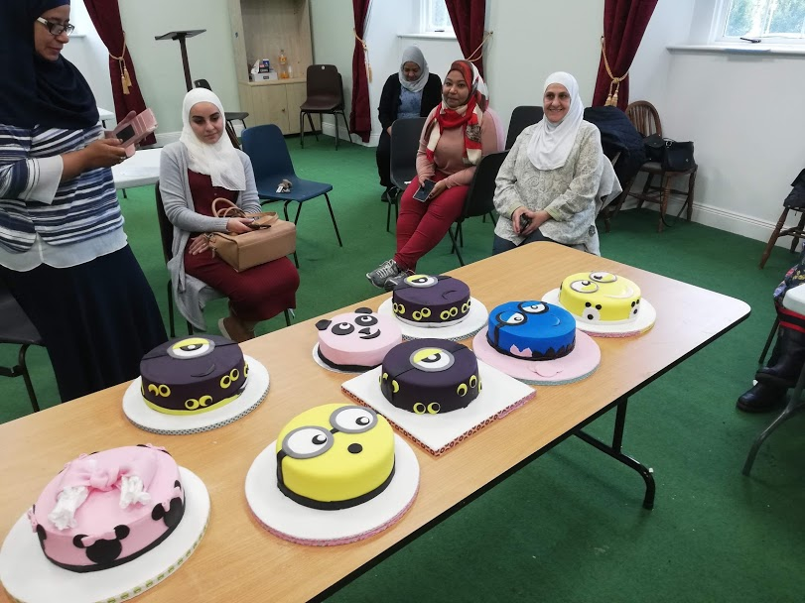
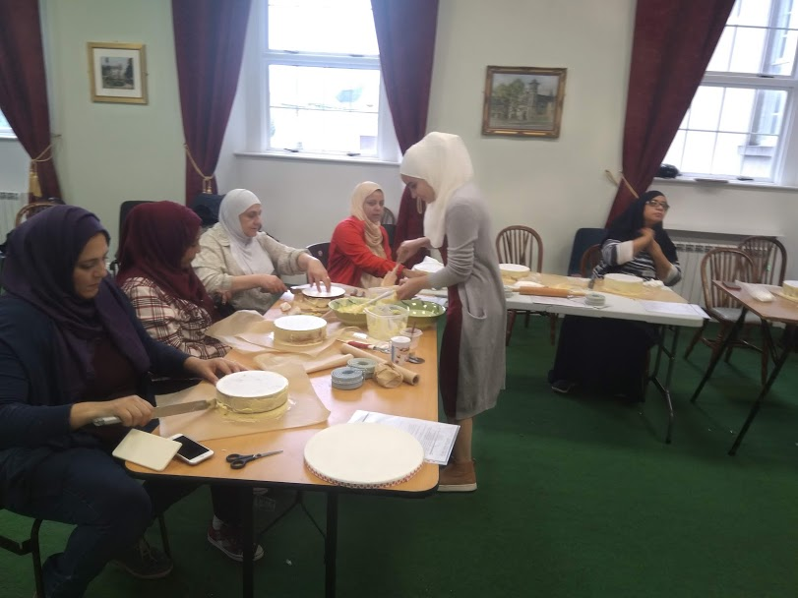
Participants of the Sugar craft course

Slide 10
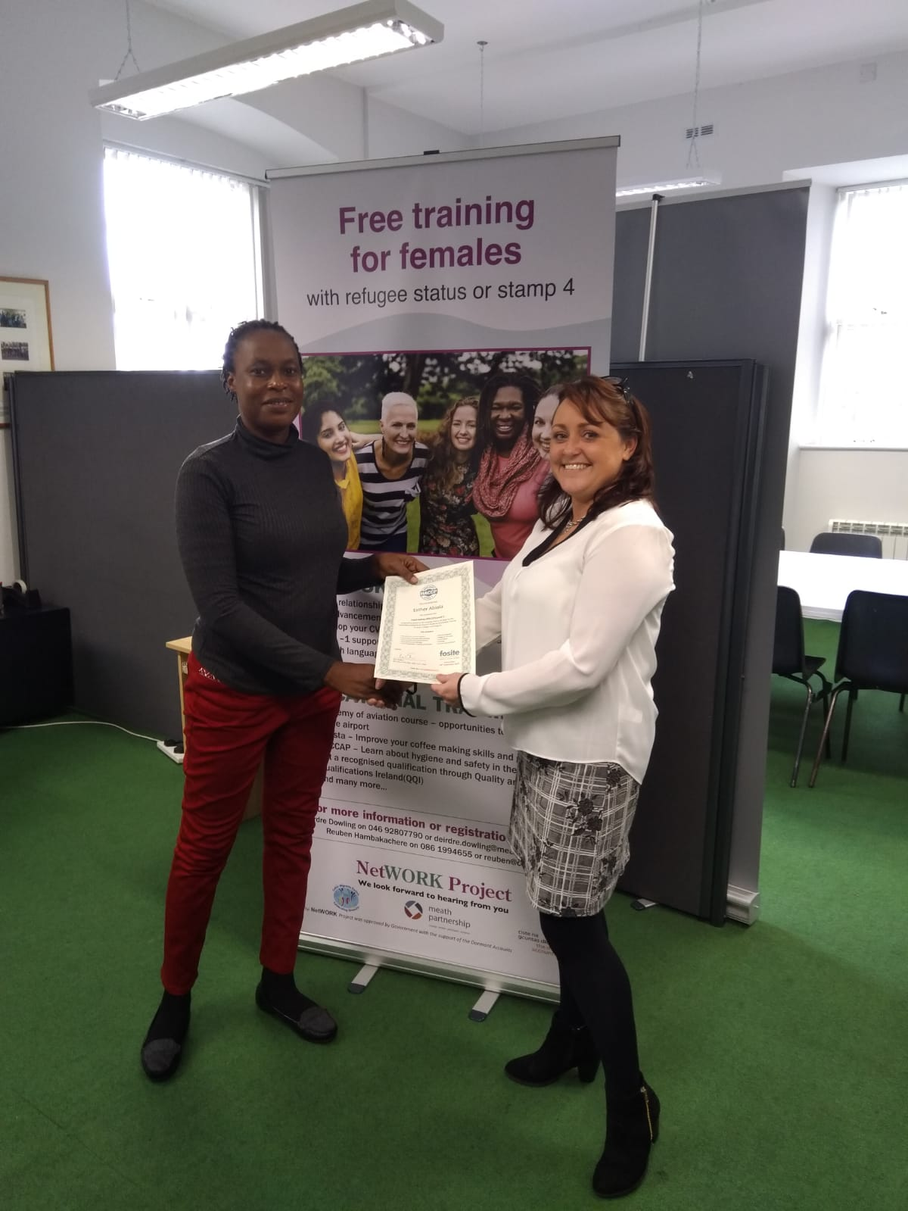
Participant of the HACCP course

Slide 11
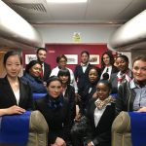
Further Supports
Our first graduates from the Academy of Aviation course

Slide 12
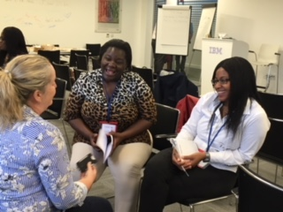
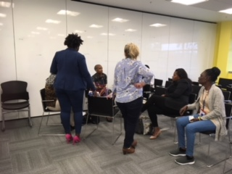
Corporate visit to IBM
Participant listening to cv and interview skills tips

